Slide 1
Lecture 4 Introduction to maximum likelihood estimation
Kristin Privitera-Johnson
FISH 553 Advanced R
School of Aquatic and Fishery Sciences
University of Washington

Slide 2
More on loops
Very often, we need to loop through a series of values, calculate something for each, and store the result
General strategy
Find out how many iterations there will be (niter)
Make a vector of the values to loop over
Create a results vector of length niter
Loop from i in 1:niter
Conduct the analysis based on the ith element of values
Store the result in the ith element of results

Slide 3
Storing for-loop results, vector
mean.norm <- function(n=c(5,10,15,30,50,100)) {
niter <- length(n)
values <- vector(length=niter)
for (i in 1:niter) {
values[i] <- sd(rnorm(n=n[i], mean=0, sd=1))
}
return(values)
}
mean.norm()
Number of iterations
Create a vector to store the results
Loop from 1 to niter, not over the set in n
Calculate using the ith element of n
Store in the ith element of values
Return the vector of answers

Slide 4
plot(mean.norm(n=2:500))
SD of samples
Number of samples from rnorm(mean=0, sd=1)

Slide 5
Storing for-loop results, matrix
mean.norm.mat <- function(n=c(5,10,15,30,50,100),
nrep=100) {
niter <- length(n)
values <- matrix(nrow=nrep, ncol=niter)
for (i in 1:nrep) {
for (j in 1:niter) {
values[i,j] <- sd(rnorm(n=n[j], mean=0, sd=1))
}
}
return(values)
}
x <- mean.norm.mat(nrep=1000)
Create a matrix to store the results
Add another loop for nrep
Return the matrix of answers
Side note: this is not necessarily the fastest way to program this

Slide 6
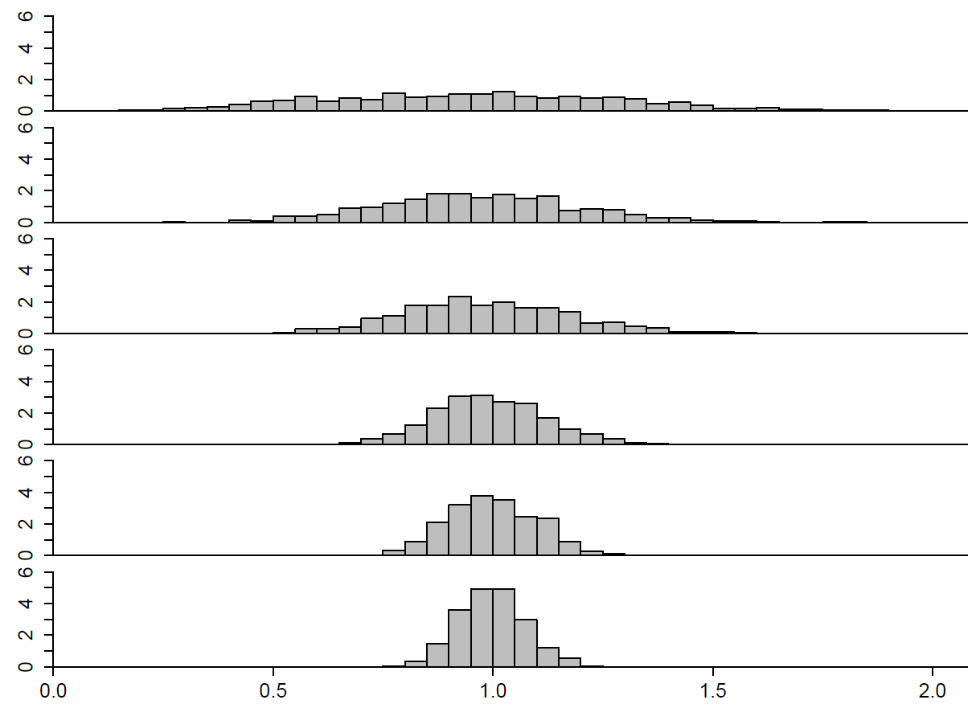
Histogram of standard deviations
n = 5
n = 10
n = 15
n = 30
n = 50
n = 100

Slide 7
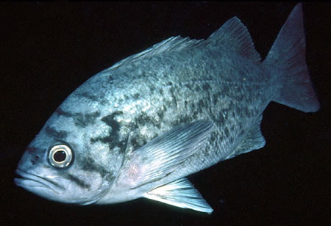
DEEP BREATH

Slide 8
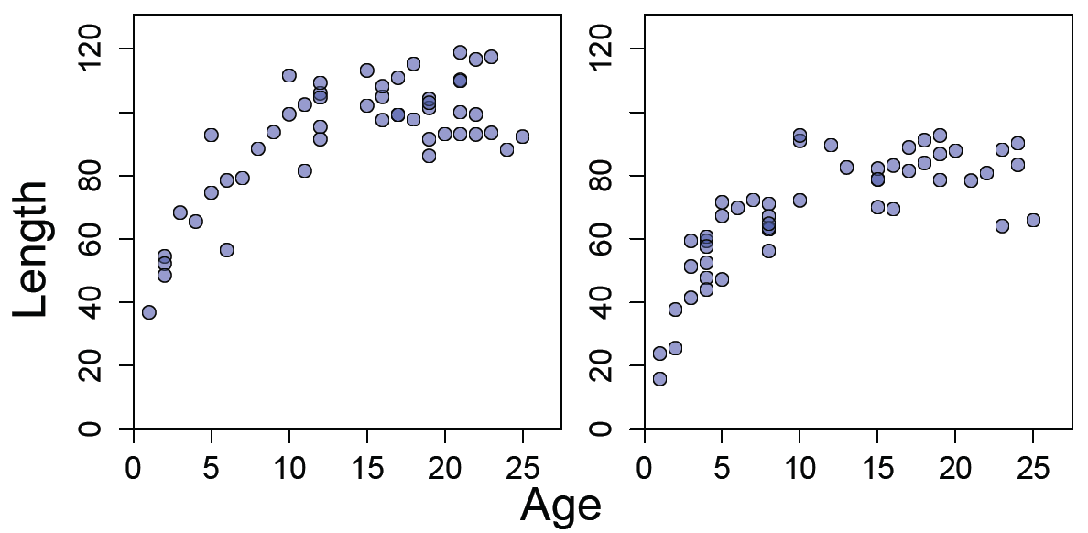
Fitting models to data
Scenario: the length (L) of a fish is related to its age (a) according to the von Bertalanffy growth curve
where is the asymptotic maximum length in cm, K is the growth rate, and t₀ is the age at zero length
~
Males
Females

Slide 9
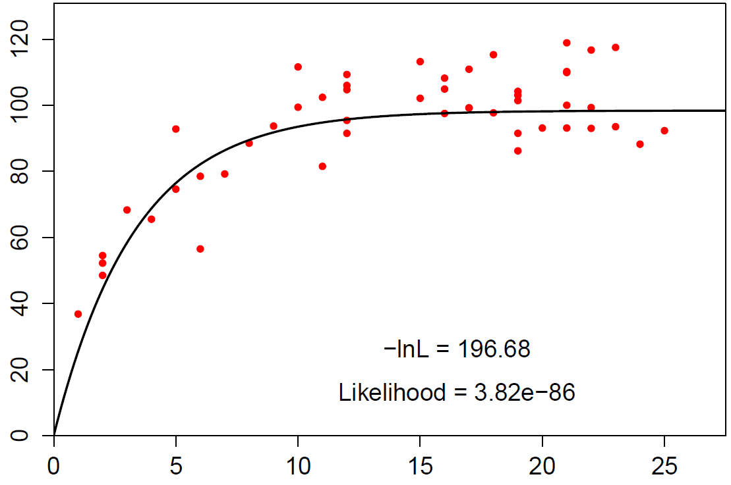
One possible model fit (males)
Length (cm)
Age (years)

Slide 10
Questions to answer
~
Estimate the parameters ( , K, t₀, σ) for this equation separately for males and females
Calculate 95% confidence intervals for asymptotic length
Can we conclude that asymptotic length differs for males and females?
(Can we use a linear model?)
(What kind of model is this?)

Slide 11
What is maximum likelihood?
To answer these questions, we will use maximum likelihood estimation
Maximum likelihood is a method for fitting a mathematical model to some data
“Fitting” means estimating the values of the model parameters that “best” explain the data
This is what t-tests and linear models use, but not the non-parametric tests

Slide 12
Simplifying the problem
The full von Bertalanffy model is:
However, the t₀ parameter is usually close to zero. To simplify the model, we will assume that t₀ = 0, and therefore
~
~
Length (cm)
Asymptotic maximum
length (cm)
Age (yr)
Growth rate (yr⁻¹)

Slide 13
Data, parameters, and error
Data
Error
~
Parameters

Slide 14
In-class exercise 1
Create a function VB.fit() with arguments Linfinity, K, gender ("male" or "female"), and filename
Tasks of the function (next slide):
Read in the data from file "LengthAge.csv" (Canvas)
Extract a vector of lengths, and a vector of ages for the specified gender (e.g. gender = "male")
Plot the lengths as a function of ages
Create a vector of xvalues for the model fit from age 0 to the maximum age in the data
Apply the von Bertalanffy model to the xvalues to get a vector of yvalues
Use lines() to plot xvalues against yvalues

Slide 15
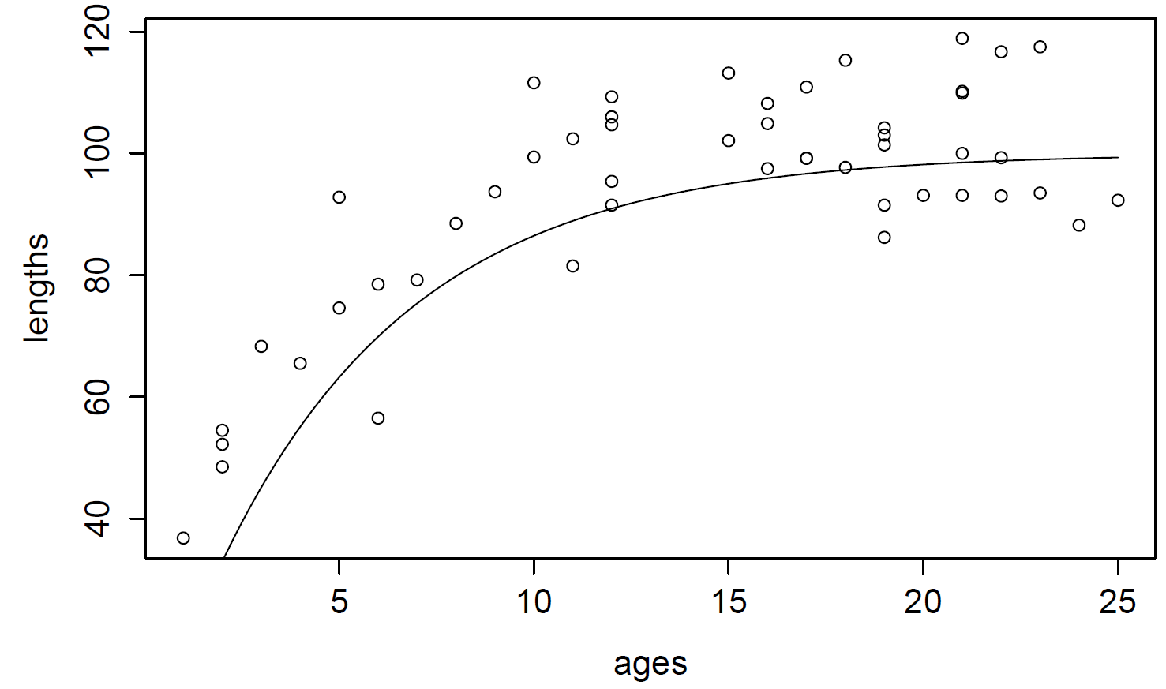
Simple plot (no beautification)
gender = "male"
L_{inf} = 100
K = 0.2

Slide 16
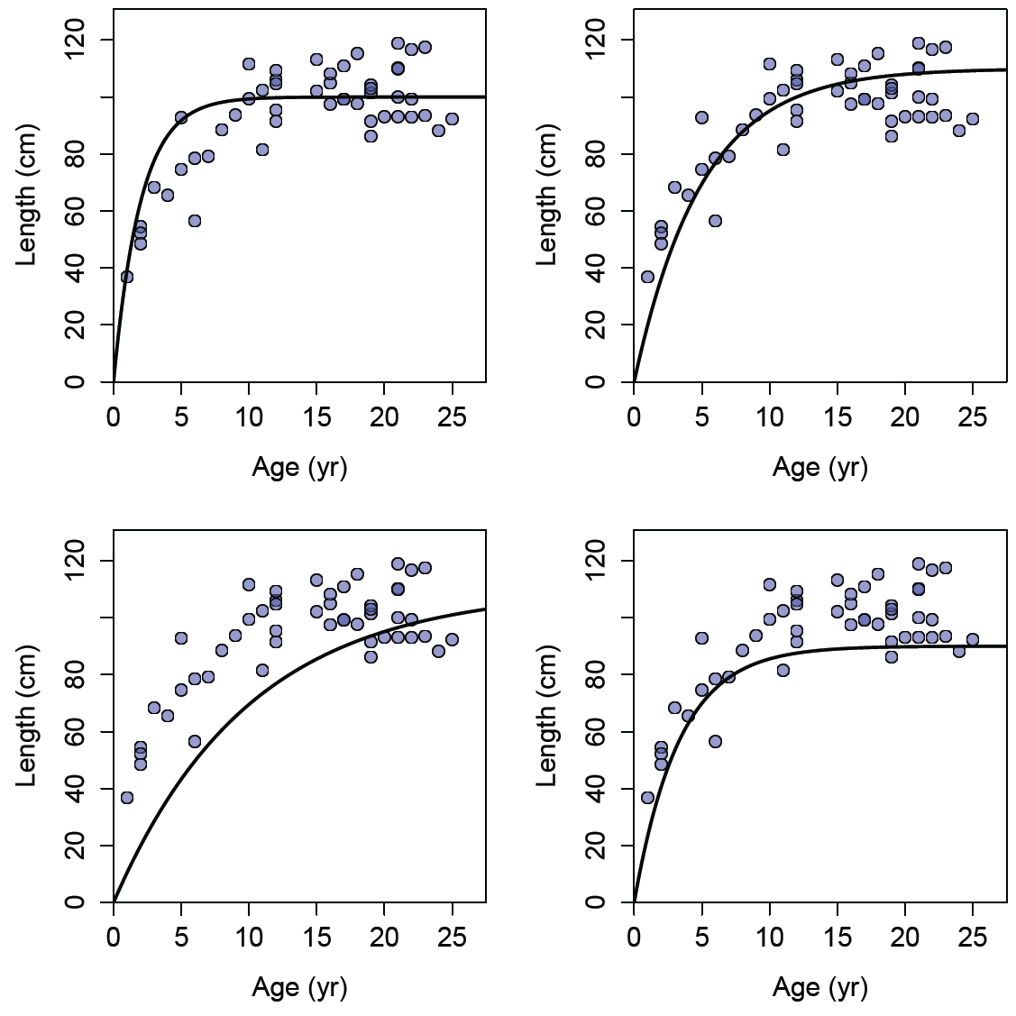
Beautified
Different values for L_{inf} and K lead to different model fits (lines)
Some model fits are “better” than others
gender = "male"
L_{inf} = 110
K = 0.5
gender = "male"
L_{inf} = 110
K = 0.2
gender = "male"
L_{inf} = 110
K = 0.1
gender = "male"
L_{inf} = 90
K = 0.3

Slide 17
How do we define “best fit”
The “best” model fit should go through the middle of the data points
There should be about as many points above the model fit as below the curve
There should be few points that are far from the model fit (“outliers”)

Slide 18
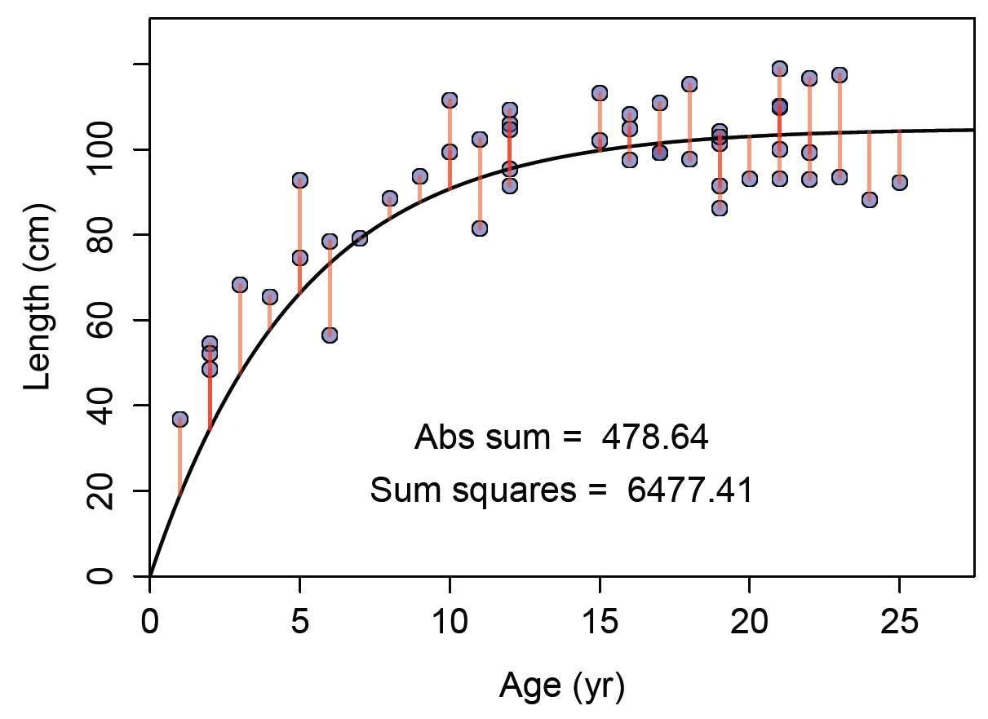
Residuals (vertical lines)
The differences between obs L and pred L are the residuals. Candidates for “best fits” might minimize the absolute values of residuals or the squares of residuals
Also called “sum of squares”

Slide 19
One possible model fit (males)
Length (cm)
Age (years)

Slide 20
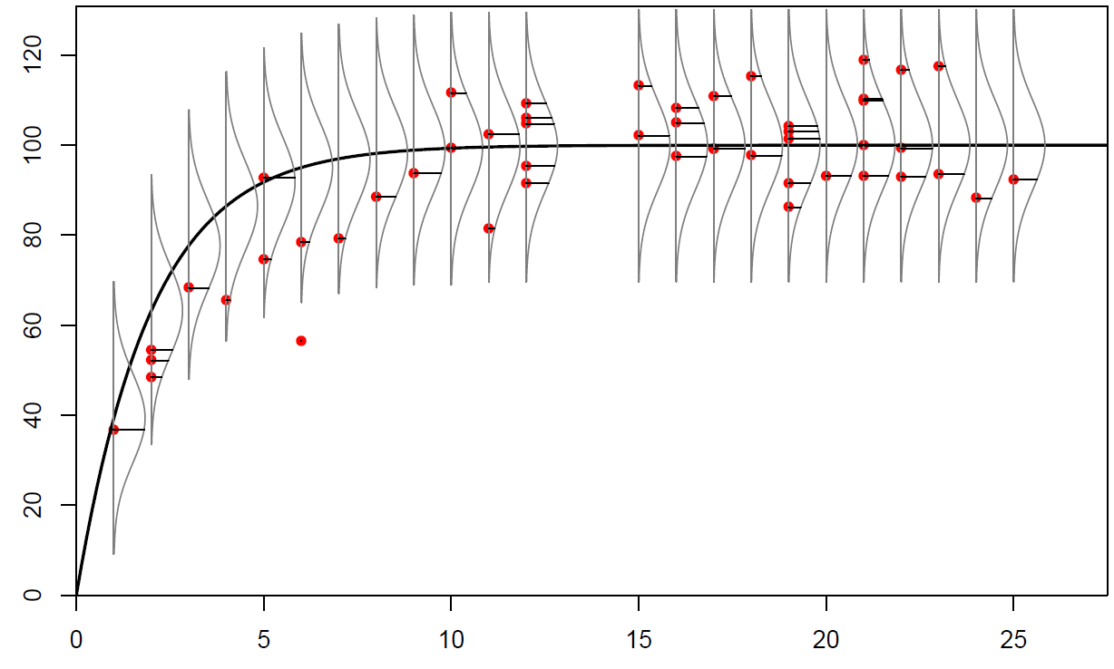
Normal likelihoods
Zoom
in
Length (cm)
Each curve is a normal distribution with the mean at the model prediction. The height of the curve at each red data point is the likelihood. The likelihood depends on the curve (normal), the model prediction at that age (mean), the data points, and the standard deviation chosen (σ=10 here)
Age (years)
5 LikeDensLines.pdf

Slide 21
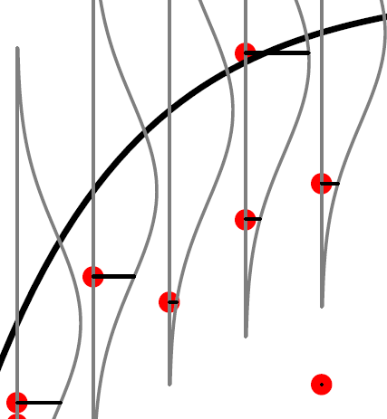
Zoom in...
This data point has a high likelihood. The curve here is high
This data point has a lower likelihood
This data point has a very low likelihood. It is so far in the tails of the curve that I didn’t even plot the curve out here
The highest likelihood is when the data point equals the model-predicted length

Slide 22
Normal likelihood: SD = 10
Length (cm)
Age (years)
5 LikeDensLines.pdf

Slide 23
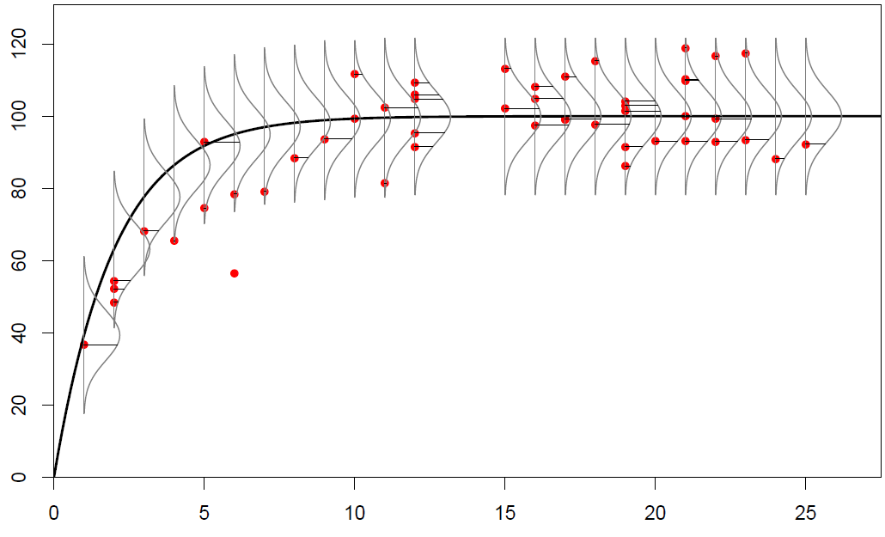
Normal likelihood: SD = 7
Length (cm)
When the standard deviation (sigma) is smaller, the likelihood is higher near the model prediction, but lower far from the model prediction
Age (years)
5 LikeDensLines.pdf

Slide 24
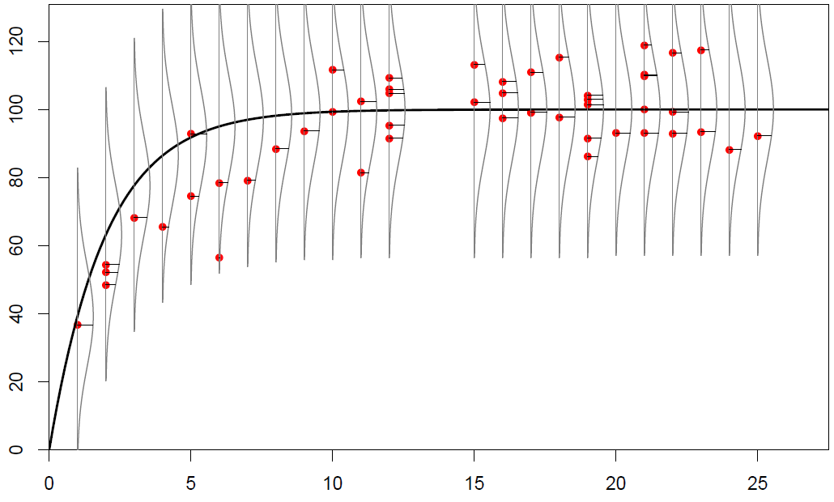
Normal likelihood: SD = 15
Length (cm)
When the standard deviation (sigma) is bigger, the likelihood is lower near the model prediction, but higher far from the model prediction
Age (years)
5 LikeDensLines.pdf

Slide 25
Probability vs. Likelihood
Slide credit: Tim Essington, FISH 454
Mathematically, they are identical
Likelihood(parameter | event) = P ( event | parameter)
In practice, they mean different things
Probability Likelihood
Outcome is unknown Outcome is known
PDF parameters known PDF parameters unknown

Slide 26
Maximum Likelihood Estimation
Slide credit: Tim Essington, FISH 454
You want to estimate parameter values from data
You can calculate the probability of the data for different parameter values
It makes sense to choose the parameter value for which the observed data are as probable as possible
This is the “Maximum Likelihood Estimate”

Slide 27
What likelihood isn’t
Slide credit: Tim Essington, FISH 454
Likelihood does NOT give you the probability of the parameter value
P (parameter | data ) ≠ P (data | parameter)
So, when we say “maximum likelihood”, we aren’t saying that the parameter value is most likely
Instead, it means the data are most likely to have occurred given that value

Slide 28
Maximum likelihood estimate (MLE)
For every data point L_{i,obs}, calculate the likelihood from the normal distribution, given a VB-predicted length L_{i,pred}, and a standard deviation (σ)
The total likelihood of the model fit to the data is the product of each L_{i} value
The maximum likelihood estimates are the values of K, L_{inf}, and σ that result in von–Bertalanffy-predicted lengths L_{i,pred} that maximize the total likelihood
This L is likelihood, not length
Equation for one data point’s horizontal line in the previous plots

Slide 29
DEEP BREATH

Slide 30
Negative log-likelihood
Products of likelihoods produce tiny numbers, such as 10⁻⁸⁰, that computers don’t handle very well
However, maximum likelihood estimates occur at the same values of K, L_{inf}, and σ as the minimum negative log-likelihood
Start with the normal likelihood
Take the negative log likelihood
The negative flips the curve so we look for a minimum instead of a maximum
The logarithm turns tiny numbers into usable numbers:
-ln(10⁻⁸⁰) = 184
Remember:
ln(a\b)=ln(a)-ln(b)
ln(ab)=ln(a)+ln(b)

Slide 31
Product of likelihood, sum of -lnL
The MLE is where the product of the likelihoods is highest
Now ln(x₁ × x₂×...) = ln(x₁)+ln(x₂)+..., therefore
Simplifying produces this equation
This is the normal negative log-likelihood
This is the sum of squares! Note the residuals here L_{obs}-L_{pred}

Slide 32
Calculating –lnL_{tot} in R code
LA <- read.csv(filename)
Ages<-LA[LA$Gender==gender,]$Ages
Lengths<-LA[LA$Gender==gender,]$Lengths
model.predL <- Linfinity*(1-exp(-K*ages))
ndata <- length(ages)
NLL <- 0.5*ndata*log(2*pi) + ndata*log(sigma) +
1/(2*sigma*sigma) * sum((lengths-model.predL)^2)
Read in the data and extract the lengths and ages for one gender
function parameters
Use VB model to calculate predicted lengths (ages is a vector)
What is n? The number of data points
Calculate the negative log-likelihood

Slide 33
DEEP BREATH

Slide 34
Using manipulate()
Package "manipulate" has a function manipulate() which allows the user to create interactive plots in RStudio (and sadly only RStudio)
Each argument in the function must be called in exactly the same order in manipulate()
You can use sliders, pickers, and checkboxes to allow the user to choose different values for the function arguments
The function is then rerun and the results plotted with the new values

Slide 35
How I used manipulate()
Lecture 5 manipulate.r
VB.like.sliders <- function(gender, Linfinity, K,
sigma, add.curve, add.lines) {
#make plot, calculate NLL, report NLL
}
manipulate(VB.like.sliders(gender, Linfinity,
K, sigma, add.curve, add.lines),
gender = picker("Male","Female"),
Linfinity = slider(min=40, max=120,
initial=90, step=0.001),
K = slider(min=0.05, max=0.7,
initial=0.3, step=0.001),
sigma = slider(min=2, max=30,
initial=7, step=0.001),
add.curve = checkbox(TRUE, "Add curve"),
add.lines = checkbox(TRUE, "Add lines"))

Slide 36
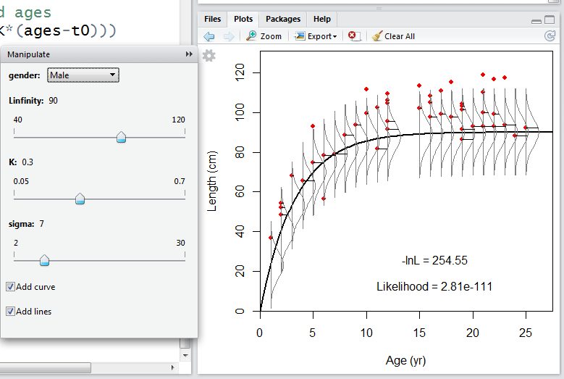

Slide 37
Practice Exercise
Group class activity to find the lowest possible total negative log-likelihood (males)
Use RStudio and package manipulate to run the code in "Lecture 5 manipulate.r"
Play with the sliders for K, L_{inf}, and σ to find values that produce the smallest possible negative log-likelihood, -lnL_{tot}
If you find a better value, go to the board and write down the values you found for K, L_{inf}, σ, and -lnL_{tot}

